Slide 1
SQL Server to Azure SQL: Security
Anna Hoffman, Data & Applied Scientist
Microsoft Program Management – Azure SQL
Notes:
This is intended for SQL Server people. But if you’re not a SQL Server person, still a good way to get a general understanding of security for Azure SQL.

Slide 2
Agenda
Azure SQL overview
Capabilities and tasks
Identity and access management
Network security
Data protection
Security management
Questions (now and later)

Slide 3
Azure SQL
Choose the right Azure database for your needs
SQL Server on Azure virtual machines
Azure SQL managed instance
Azure SQL Database
Best for migrations and applications requiring OS-level access
Best for most lift-and-shift migrations to the cloud
Best for modern cloud applications. Hyperscale and serverless options are available
Infrastructure as a service
Platform as a service
Notes:
SQL virtual machines
Azure manages the host and hardware
You manage the Virtual Machine
Azure provides value-add services
Managed instances
Azure manages the host, hardware, and Virtual Machine
You manage the SQL Server
Azure provides PaaS services
Databases {explain logical server!}
Azure manages the host, hardware, virtual machine, and SQL Server
You manage the database
Azure provide PaaS services

Slide 4
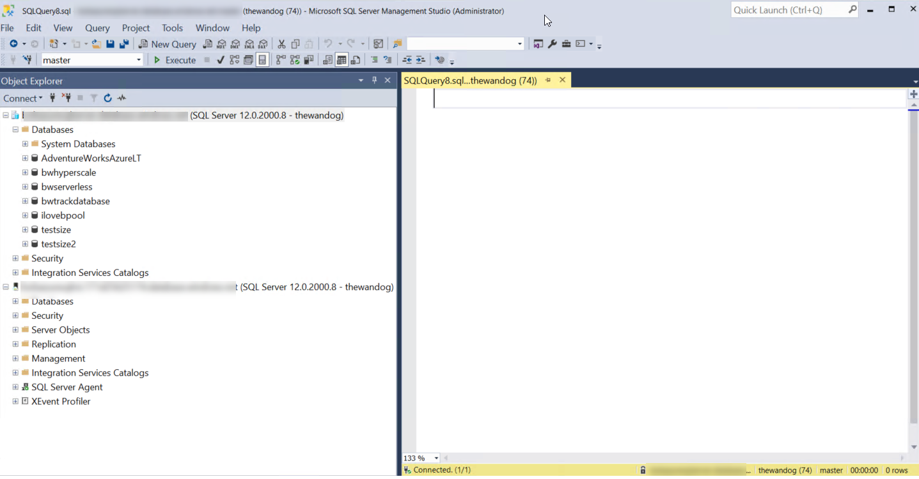
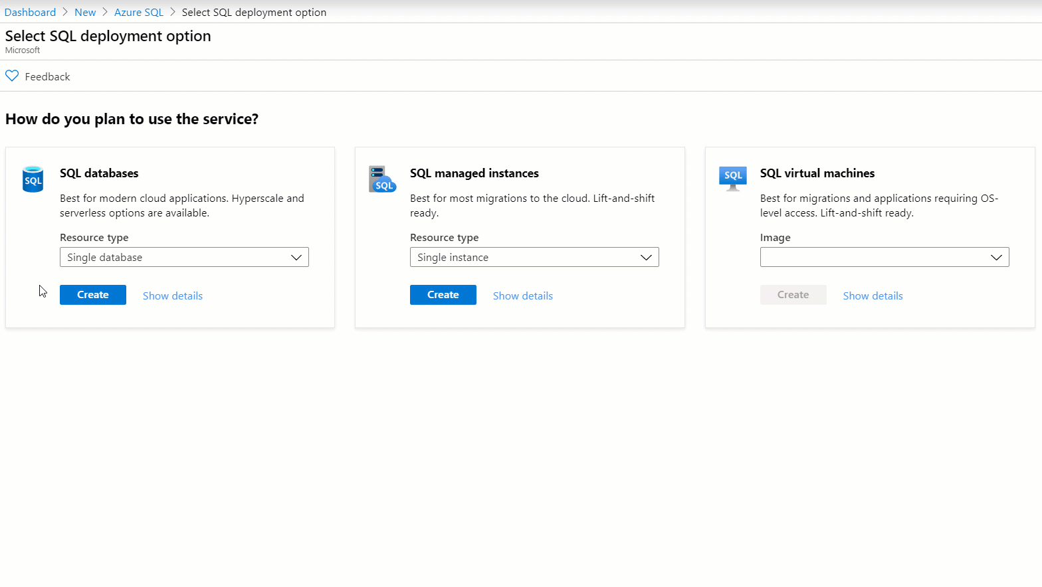
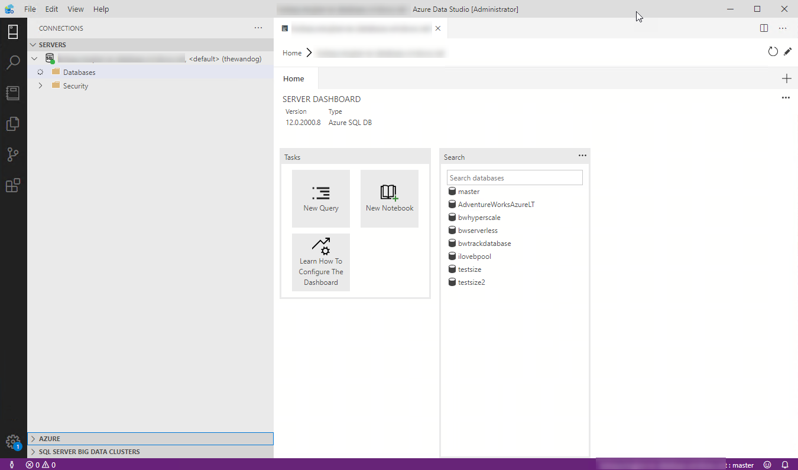


Interfaces for Azure SQL
T-SQL
Powershell
az cli
REST API
sqlcmd
bcp

Slide 5
Security overview
Capabilities
Active Directory Authentication
Data encryption
Tasks
Setup and configure network Security
Setup and configure authentication and authorization
Advanced Data Security
Monitoring security
Setup and configure data protection
Azure RBAC and locks
Auditing
Dynamic Data Masking

Slide 6
Azure SQL Enterprise-class security
Identity & access management
Platform and network security
Information protection and encryption
Security management
Authentication options:
Azure AD, SQL Auth, Windows Auth
VNET
Advanced Threat
Detection
Vulnerability
Assessment
Encryption-in-use
(Always Encrypted)
Firewall Rules, NSG
SQL Audit
Data Discovery &
Classification
Encryption-at-rest
(TDE)
Azure RBAC
Private Link
Audit Integration with
Log Analytics and
Event Hubs
Azure Security Center
Encryption-in-flight
(TLS)
Roles & Permissions
User-managed keys
Row-level security
Dynamic Data Masking

Slide 7
Azure Role Based Access Control (RBAC)
All Azure operations for Azure SQL are controlled through RBAC
Think of this as security rights outside the Managed Instance or Database
Security principal and role-based system
Scope includes subscription, resource group, and resource
Decoupled from SQL Security (today)
Applies to operations in Azure portal and CLI
Allows for separation of duties for deployment, management, and usage
Azure locks help protect resources from delete or read-only
Built-in Azure SQL roles available to reduce need for owner
SQL DB Contributor
SQL Managed Instance Contributor
SQL Security Manager
SQL Server Contributor
Identity & access management
Network security
Data protection
Security management
Notes:
All Azure operations for Azure SQL are controlled through RBAC, that’s the key Azure Operations, so think of it as security rights outside of Azure SQL
Decoupled from SQL security today
Built-in roles available to reduce need for higher level roles like Owner or Contributor. So effectively, you can use these roles to have certain individuals deploy Azure SQL resources (or manage security polices) but grant other users actual access to user or manage the MI or database.
SQL DB or MI Contributor – Can create and manage databases but can’t access the database/MI (Ex. to connect and read data)
SQL Security Manager - Manage security policies for MI and databases (like auditing) but not access the MI or database
SQL Server Contributor – Manage servers and databases but not access them.
Scope includes subscription, resource group, and resource
Decoupled from SQL Security (today)
Applies to operations in Azure portal and CLI
Allows for separation of duties for deployment and Azure SQL management and usage
Azure locks help protect resources from delete or read-only

Slide 8



Authentication to Azure SQL
“Mixed Mode” authentication forced
SQL Auth for deployment: server admin.
Server-level principal for logical server for DB
Member of sysadmin server role for MI
loginmanager and dbmanager roles for limited server admins
Azure Managed Instance
Azure AD Server Admin
SQL or Azure AD Logins
Database Users
Need Windows Auth? Use Azure AD Authentication
Azure SQL Database
Azure AD Server Admin
Database Users
SQL Server Contained Database supported
SQL logins
Contained Database Users including Azure AD (recommended)
Identity & access management
Network security
Data protection
Security management
Notes:
“Mixed Mode” authentication forced and cannot be changed
logins for Azure SQL Database are created in the context of the logical server or master database.
During database server deployment you have to specify a “server admin” which is a server level principal and effectively has “sysadmin” rights for the server and all databases.
You can create other more limited admins using the following database level roles in the master of the logical server:
loginmanager role is a database level role stored in master. Members are allowed to create logins for the database server
dbmanager is a database level role stored in master. Members can create and delete databases based on the database server.
loginmanager role is a database level role in the master of the logical server. Members are allowed to create logins for the database server
dbmanager is a database level role in the master of the logical server. Members can create and delete databases based on the database server.
CREATE LOGIN has some syntax differences for MI and DB (Ex. supporting Azure AD auth). See https://docs.microsoft.com/en-us/sql/t-sql/statements/create-login-transact-sql?view=azuresqldb-current and https://docs.microsoft.com/en-us/sql/t-sql/statements/create-login-transact-sql?view=azuresqldb-mi-current.
SQL Auth login required during deployment called server admin.
Server-level principal for logical server. Becomes default dbo for Azure SQL Database
Member of sysadmin server role for Managed Instance
Need Windows Auth? Use Azure Active Directory Authentication
CREATE LOGIN supported for both MI and Database
loginmanager and dbmanager roles for Azure Database admins
sa disabled for Managed Instance and guest disabled for database

Slide 9
Setup and configure Authentication and Authorization
Deploy with a SQL server admin
Admins can create users
Create other admins
Grant access just like SQL
Identity & access management
Network security
Data protection
Security management
Notes:
Deploy with a SQL Server admin
Both MI and Azure SQL Database Server require a SQL Server admin account and password
Create Other Admins
you can create an Azure AD server admin (just one)
You can now create SQL “admin” logins by placing them in the special loginmanager or dbmanager logical master database roles
Admins can create users
You can create SQL logins in logical master
You can create users in databases based SQL logins in logical master
In addition, you can create contained database users either with SQL auth or AAD (AAD requires an AAD server admin)
Deploy with a SQL Server admin
Both MI and Azure SQL Database Server require a SQL Server admin account and password
Create Other Admins
For MI, you can create an Azure AD server admin which is a sysadmin for the instance
You can create other sysadmin logins either with SQL logins or with AAD
For DB, you can create an Azure AD server admin (just one)
You can now create SQL “admin” logins by placing them in the special loginmanager or dbmanager logical master database roles
Admins can create users
For MI,
Now create logins and users just like you would for any SQL Server except instead of Windows Auth you can use AAD
A SQL Server Contained Database is supported just like SQL Server
Users CAN not be based on AAD
For DB,
You can create SQL logins in logical master
You can create users in databases based SQL logins in logical master
In addition, you can create contained database users either with SQL auth or AAD (AAD requires an AAD server admin)

Slide 10
Demo Authentication
Notes:
Show connecting in SSMS with SQL auth first
Then add AAD admin
Create logins
Give access
Contained DB users
Give access with AAD

Slide 11


WEST US
SQL Connectivity
Architecture
23.99.34.75
GW
GW
mysqldbsrv.database.windows.net
104.42.238.205
GW
GW
westus1-a.control.database.windows.net
104.42.238.205,1433
GW
proxy (default)
(1) redirect-find-db
GW
GW
(2) redirect-query
..westus1-a.worker.database.windows.net
13.123.237.158, [11000 -11999]
Identity & access management
Network security
Data protection
Security management
Notes:
https://docs.microsoft.com/en-us/azure/sql-database/sql-database-connectivity-architecture
Key points:
Explain from perspective of a client connection
Proxy/Redirect are server level settings apply to all databases
Clients need specific connectivity for Redirect to work – port range plus all Azure Ips in a region

Slide 12



Network security – SQL Database
Allow access to Azure services
Firewall Rules
Virtual Network Rules
VNET Peering
Private Link
VMVNET-EUS
US EAST
SQLDBVNET-EUS
No access to Internet
US EAST
Azure VM
10.0.0.3
127.33.201.5
Azure VM
10.0.0.5
174.17.218.16
VMVNET-WUS
10.0.0.2
mysqldbsrv.database.windows.net
US WEST
mysqldbsrv.privatelink.
database.windows.net
10.0.0.5
westus1-a.control.
database.windows.net
104.42.238.205
Private Endpoint
Azure VM
102.14.157.9
10.0.0.1
VNET Gateway
VNET Gateway
Vnet2Vnet
P2S, S2S VPN Express Route
On-premises
Identity & access management
Network security
Data protection
Security management
Notes:
Private link:
Benefits:
Private endpoint for Azure SQL (server level)
On-premises connectivity via Express Route/VPN
Data exfiltration protection
Can be part of network monitoring strategy using a Network Virtual Appliance (NVA)
Currently in public preview for:
Azure SQL Database (singleton databases)
Azure SQL Data Warehouse
Azure Storage

Slide 13

Network security – SQL Managed Instance
VNET Peering
VMVNET-EUS
US EAST
SQLDBVNET-EUS
US EAST
Azure VM
10.0.0.3
127.33.201.5
sql-mi-2.25984.database.windows.net
Azure VM
10.0.0.5
10.0.0.254
174.17.218.16
VMVNET-WUS
10.0.0.2
US WEST
sql-mi-1.259fs.database.windows.net
Private Endpoint
10.0.0.252
Azure VM
MI Subnet
102.14.157.9
10.0.0.1
VNET Gateway
VNET Gateway
Vnet2Vnet
P2S, S2S VPN Express Route
On-premises
Identity & access management
Network security
Data protection
Security management
Notes:
Trying to figure out how to compare this to a SQL Server network security scenario? I think the only one that probably applies is Windows Firewall which is a reality for all SQL Server deployments even in their data center.

Slide 14
Demo Configure and manage Firewall/Vnet rules

Slide 15
Demo Create and manage Private Link

Slide 16
Setup and configure Network security
SQL Database
Configure Private Link if possible
Not possible?
Configure Virtual Network rules
SQL Managed Instance
Configure virtual network and subnet before deployment
Set Allow Access to Azure services OFF
Configure Firewall rules
Follow standard networking practices to enable connectivity
Identity & access management
Network security
Data protection
Security management
Notes:
https://docs.microsoft.com/en-us/azure/cloud-adoption-framework/reference/networking-vdc
https://docs.microsoft.com/en-us/azure/cloud-adoption-framework/reference/vdc

Slide 17

Data Encryption
Encrypted connections – TLS forced for Azure Database
TLS 1.2 forced for Azure Managed Instance outbound connections
Column Level Encryption
Transparent Data Encryption (TDE) for data at rest (on by default for Database)
Always Encrypted for data in use
Integration with Azure Key Vault (BYOK)
Identity & access management
Network security
Data protection
Security management
Notes:
Encrypted connections
Encrypted connections required and forced using TLS
Force encryption on client to avoid server negotiation
Don’t trust server certificate as best practice
Column Level Encryption
Supported just like SQL Server
Transparent Data Encryption (TDE)
On by default for all new Azure SQL Databases
Customer-managed keys with Azure Key Vault
Always Encrypted
Supported just like SQL Server
Store keys in Azure Key Vault
Enclave support not yet available
Always encrypted
Client side Encryption-Client-side encryption of sensitive data using keys that are never given to the database system
Encryption Transparency-Client driver transparently encrypts query parameters and decrypts encrypted results
Queries on Encrypted Data-Support for equality comparison, including join, group by and distinct operators via deterministic encryption

Slide 18
Demo Confirm TDE is enabled

Slide 19

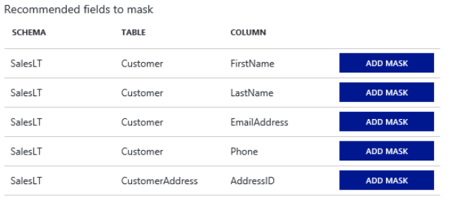
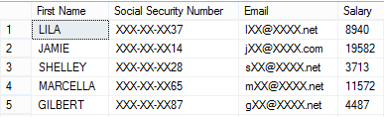
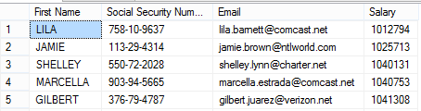
Dynamic Data Masking
ALTER TABLE [Employee] ALTER COLUMN [SocialSecurityNumber]
ADD MASKED WITH (FUNCTION = 'Partial(0,"XXX-XX-",2)')
ALTER TABLE [Employee] ALTER COLUMN [Email]
ADD MASKED WITH (FUNCTION = ‘EMAIL()’)
ALTER TABLE [Employee] ALTER COLUMN [Salary]
ADD MASKED WITH (FUNCTION = ‘RANDOM(1,20000)’)
GRANT UNMASK to DataOfficers
Normal Endusers
Role DataOfficers
Identity & access management
Network security
Data protection
Security management
Notes:
TODO add visual of the portal -- formatting

Slide 20
Setup and configure data protection
Ensure applications force connection encryption
Evaluate use of TDE
Take advantage of Dynamic Data Masking
Setup Always Encrypted for advanced protection
Identity & access management
Network security
Data protection
Security management
Notes:
Ensure applications force connection encryption
Setup Always Encrypted for advanced protection

Slide 21

Auditing in Azure SQL
Audit Azure Level Activities with Azure Monitor Logs
SQL Server Audit used for Azure SQL Managed Instance
Logs stored in Azure Blob Storage
Azure Monitor Logs and Event Hub supported
Failure or Continue options (but no Shutdown)
Azure SQL Auditing for Azure SQL Database
Powered by SQL Server Audit
Server and Database Audit Action Groups and Actions supported
Store and Analyze Audits:
Azure Log Analytics with Dashboard
Azure Storage account
Azure Event Hubs
Identity & access management
Network security
Data protection
Security management
Notes:
You can audit at the azure level with Azure monitor logs
SQL Server Audit for Azure SQL Managed Instance
Works just like SQL Server except for storage is Azure Blog Storage for .xel files
Azure SQL Auditing
Based on SQL Server Audit but has certain default action groups.
You can also store and analyze audits with a few different options, and I’ll show those at the end of the session in a demo where I bring a lot of these things together
Default action groups are BATCH_COMPLETED_GROUP, SUCCESSFUL_DATABASE_AUTHENTICATION_GROUP, FAILED_DATABASE_AUTHENTICATION_GROUP
No exact Audit-Level Audit Action Group equivalent capability but some is available through Activity Logs and BATCH_COMPLETED_GROUP audit

Slide 22
Demo Configure Auditing
Notes:
For now, I just want to show you how I configured this

Slide 23
Monitoring and managing Security
Use Activity Logs and RBAC auditing for Azure monitoring
Azure Managed Instance
Configure SQL Server Audit for Azure Managed Instance
Engine can track for failed/successful logins in Azure Managed Instance
Azure SQL Database
Configure Azure SQL Auditing for Azure Database
DMVs, Metrics, and Alerts to monitor security events for Azure Database
sys.event_log
# Successful or Failed Connections
# Blocked by Firewall
Setup alerts for Advanced Threat Protection
Monitor Azure Security Center
Identity & access management
Network security
Data protection
Security management
Notes:
I can leverage RBAC auditing for azure related monitoring
For MI and DB I want to make sure I have auditing configured and there are a few differences for SQL DB, like I can use sys.event_log to get some extra info, since I don’t have access to the full engine like in MI
You’re definitely going to want to set up ATP which we’ll talk about and demo, and you can leverage the Azure Security Center to see the security of all your resources and databases all up.

Slide 24
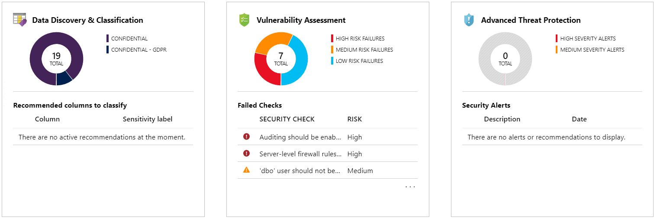
Advanced Data Security
Identity & access management
Network security
Data protection
Security management
Notes:
Something that really helps for monitoring and managed security is ADS.
Some capabilities are in SQL Server on prem, but ATP is not, and you don’t get a dashboard like what you’ll see shortly.
TODO: Does the T-SQL syntax for Data Classification work on Azure SQL?
SSMS Vuln Assessment works against Azure SQL
SSMS Data Classification works against MI

Slide 25
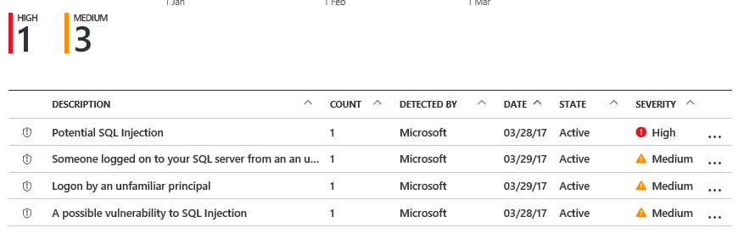


Advanced Threat Protection Detect unusual and harmful attempts to breach your database.
Detects potential SQL injection attacks
Detects unusual access & data exfiltration activities
Actionable alerts to investigate & remediate
View alerts for your entire Azure tenant using Azure Security Center
Attacker
(2) Possible threat to
access / breach data
User
Apps
Azure SQL Database
Developer
Audit Log
Threat Detection
(1) Turn on Threat Detection
(3) Real-time actionable alerts
Identity & access management
Network security
Data protection
Security management
Notes:
So what is ATP? It’s going to allow you to respond to unusual and harmful attempts to breach your database.
1) It is super simple to enable and requires no modifications to your application code.
2) It provides you with a set of world-class algorithms that learn, profile and detect potential SQL injections and unusual behavior patterns.
3) It triggers security alerts upon detection, which include clear description and actionable investigation and remediation steps.

Slide 26
Demo Advanced data security

Slide 27
(Bonus) Demo Data classification, Dynamic data masking, and SQL Audit

Slide 28
Summary
Be aware of the security capabilities Azure SQL brings to the table
Configure your network to allow connections from the right places only
Leverage Advanced data security to monitor, manage, and address security concerns
Select the authentication method that works for your organization
Protect your data with Data Encryption best practices

Slide 29
Thank you!! Anna Hoffman @AnalyticAnna aka.ms/annalytics – presentations including this deck aka.ms/dataexposed – Channel9 aka.ms/dataexposedyt – YouTube aka.ms/sqlworkshops – check out the Azure SQL Workshop (preview) *this session was Module 3 in the Azure SQL Workshop*

